Slide 1

Satellite Internet Communication Using OSI Layers
Presented By: Guided by:
Name: Haashini P Dr. P . Jesu Jayarin
Register No.: 192524047

Slide 2


Introduction
• Satellite Internet provides internet access through communication satellites.
• Connects remote and rural areas.
• Data travels via satellites and ground stations.
• OSI model explains data transmission layer by layer.
• Ensures reliable and secure communication.

Slide 3
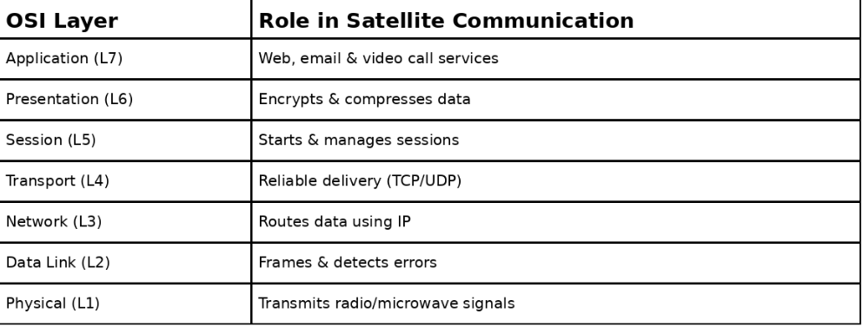
OSI Layers in Satellite Communication

Slide 4
Satellite Data Transmission Process
1. User sends a request.
2. Data passes through OSI layers.
3. Modem converts data to radio signals.
4. Satellite forwards signals to ground station.
5. ISP returns response through the same path.

Slide 5
Applications & Advantages
Applications:
• Remote villages
• Aviation & Ships
• Military
• Disaster recovery
Advantages:
• Global coverage
• Reliable connectivity
• Easy deployment

Slide 6
Conclusion
• OSI layers organize communication efficiently.
• Satellite Internet provides global connectivity.
• Useful for remote and inaccessible regions.
• Each layer has a specific networking role.
• Essential for modern worldwide communication.

